Slide 1
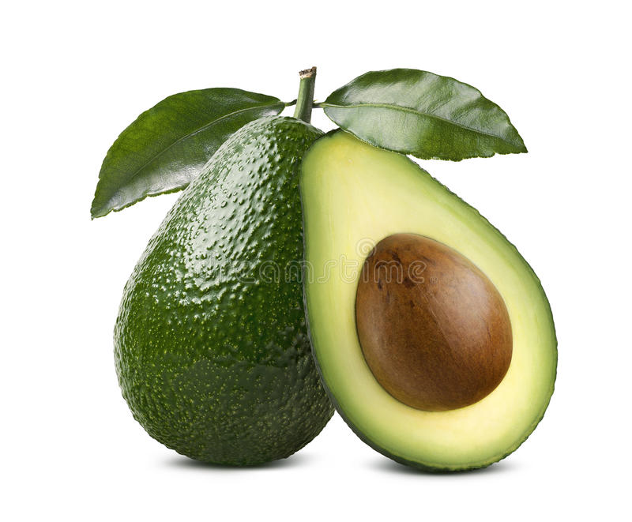
AVOCADO
A LOOK AT HAAS AVOCADO’S PRICES AND AVAILABILITY IN US CITIES
BY LUCKY GBELODE
SEPTEMBER, 2022

Slide 2
INTROUCTION
The dataset represents weekly 2018 retail scan data for National retail volume (units) and price. Retail scan data comes directly from retailers’ cash registers based on actual retail sales of Hass avocados.

Slide 3
BUSINESS TASK
We are going to explore the following questions in our analysis
What time of the year are Avocado prices cheapest?
Which Cities are Avocados available in large quantities ?
Which of the Avocado type is cheaper and more popular with customers?
What is the price and volume trend in Los Angeles?
Which Cities have the lowest Avocado prices?
Which Cities have the highest Avocado prices?
Are Avocados prices rising generally?

Slide 4
DATA SOURCES
The dataset are publicly available in kaggle. Data are from retailers’ cash registers based on actual retail sales of Hass avocados. The data is a structured data.

Slide 5
DATA WRANGLING
Data was imported into excel.
Columns were named with descriptive names.
Date was properly formatted, convert to date type
Month, Quarter and year field were extracted from the date column
Total volume column was created for Haas Avocado

Slide 6
What time of the year are Avocado prices cheapest?
Avocado Prices are cheapest in the month of January, February and March (The first Quarter of the year).

Slide 7
Which cities are Avocados available in large quantities ?
Avocados are available in larger quantities Los Angeles and New York than other US cities.

Slide 8
AVOCADO PRICE AND VOLUME TREND IN LOS ANGELES
Prices are generally lowest in the first quarter of the year and highest in the third quarter of the year.
Volume are generally lowest in the fourth quarter and highest in the first quarter of the year.

Slide 9
CITIES WITH THE LOWEST AVOCADO PRICES
Houston has the lowest Avocado prices.

Slide 10
CITIES WITH THE HIGHEST AVOCADO PRICES
Hartford Springfield pays the highest price for Avocado.

Slide 11
REGION BY SALES
The West and North East are the top regions for Avocado sales.

Slide 12
AVOCADO PRICE AND VOLUME TREND
Avocado prices are affected by seasonality, but it has also been rising over the years.
Avocado volume is affected by seasonality.

Slide 13
COMPARING THE DIFFERENT AVOCADO SIZES
The small and large Haas bag sizes are more popular with customers but their volumes bought by consumers have remain flat the same over the years.

Slide 14
AVOCADO TYPE TREND
The Conventional type of Avocado has been very popular with customers.

Slide 15
CONCLUSION
Avocado prices are cheapest in the month of January, February and March (The first Quarter of the year).
Houston has the lowest Avocado prices and Hartford Springfield pays the highest price for Avocado.
Avocado prices and volume are affected by seasonality . However, prices has been rising over the years.
The Conventional Avocados are very popular with customers.
In Los Angeles, prices are generally lowest in the first quarter of the year and highest in the third quarter of the year while volumes are generally lowest in the fourth quarter and highest in the first quarter of the year.

